Slide 1
SAP (Sybase) Replication Server Overview

Slide 2
SAP Sybase Replication Server
SAP Replication Server is a sophisticated transactional data movement product that moves and synchronizes data across the enterprise, without geographical distance Limitation, to meet demanding requirements in the enterprise such as guaranteed data delivery, real-time business intelligence and zero operational downtime.
Replication Server facilitates this by non-intrusively handling data at the source and target, including Sybase, Oracle, Microsoft, and IBM, while ensuring high performance and transactional integrity.
Key feature of SAP Replication Server is that it relies on a log-based replication technique: the Changed Data Capture (CDC) is not done against the data volumes of the source database, but instead by reading directly the database log.
This log-based approach reduces the workload that the replication process brings to the source database, thus enhancing the availability of this system.

Slide 3
SAP Replication Server - Main Objectives
Log-based replication process
Non-intrusive
Very high performance
Improve recovery, resumption times and minimize downtime
Bi-directional replication
Standby DB is always available and can be used for read-only report server
Fresh data to enable timelier decision
Run resource-intensive reports on reporting servers without impacting OLTP systems
Reduce information latency for reporting and optimize batch reporting
Real time data sharing and synchronization
Facilitates decentralized business operations
Enables remote applications to access data locally for improved performance
Enable business continuity in case or site-wide disaster
Maintain application availability during planned/unplanned downtime
Real-time decision support
Create Operational Data Stores (copy of OLTP production systems for daily reporting)
Real-time loading of data warehouses (SAP HANA, SAP IQ, SAP ASE, Oracle, Microsoft, IBM)

Slide 4
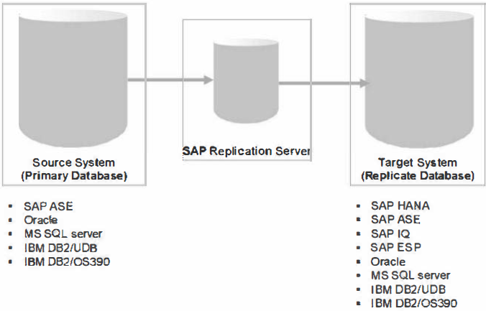
Supported Databases and Server Architecture

Slide 5
SAP Replication Server with SAP HANA
SAP Replication Server minimum version for SAP HANA support: 15.7 SP100
Heterogeneous materialization (Initial load)
Pre-requisite before you can replicate transactions
Optimized for numerous tables and big data volumes (massive parallelism)
Leverages native HANA ODBC driver
Strong bulk insert/delete capabilities
Provides Data Assurance utility for ASE and Oracle DB as primary database

Slide 6
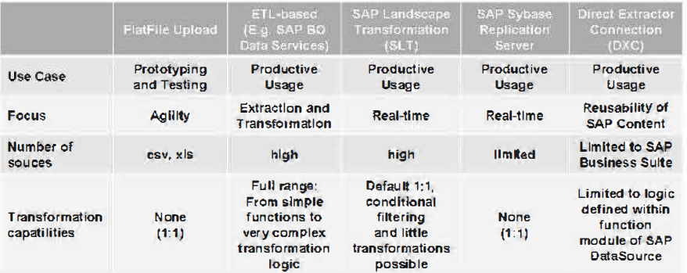
Summary of SAP HANA Provisioning methods

Slide 7
THANK YOU
Courtesy : SAP Labs Document -
HA 350 – Data Provisioning

